Slide 1
Functions Part I

Slide 2
Definition
A function in Python is a sequence of programming steps that produce a meaningful result.
We have seen many functions already:
  math.sqrt(x) #The square root of x
  pygame.draw._____ #draw a line/shape
  random.randint(a,b) #generate random numbers from a to b

Slide 3
Functions in Python
Python allows the programmer the capability to define your own functions.
Functions offer a variety of benefits:
  Functions allow you to condense a sequence of related steps into a single complicated step
  Large programs become a sequence of functions rather than a LARGE sequence of difficult-to-read python statements
  Programs with lots of functions are easier to read/edit/enhance
  Programs with functions are much easier to debug
  Programs with functions tend to have far fewer lines and often have better performance than programs without
  Taking advantage of functions will make you a better programmer

Slide 4
Ex. 1 – Creating a stamp
The following program defines a function called rollDice and calls it at various times throughout the program

Slide 5
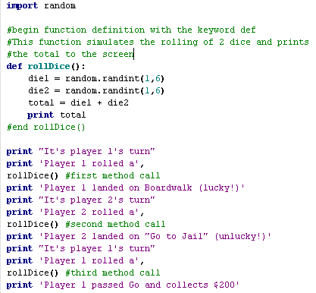
Example 1 – Source Code

Slide 6
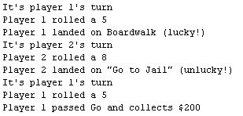
Example 1 – Sample Output

Slide 7
The def keyword
All function definitions begin with the def keyword to indicate you are defining a new function
  The indented lines that follow are the lines of code that define the behaviour of the function
Python does not execute the function code when it is defined. Instead, the function code is run each time a function call is made

Slide 8
Function Signature
The first line in any function is called a function signature
The function signature defines:
  The name of the function
  Any parameters the function may have
Example:
  def myFunction():
  myFunction is the name of a new function
  myFunction takes 0 parameters

Slide 9
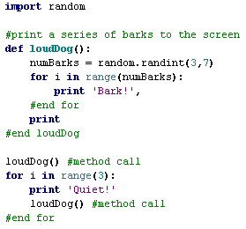
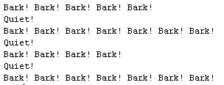
Example 2 – Loud Dog

Slide 10
Example 3 – Random Stamp
The following program creates a stamp of my name and randomly places it on the screen

Slide 11
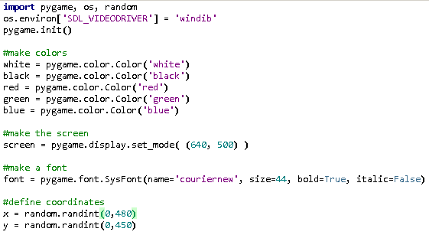
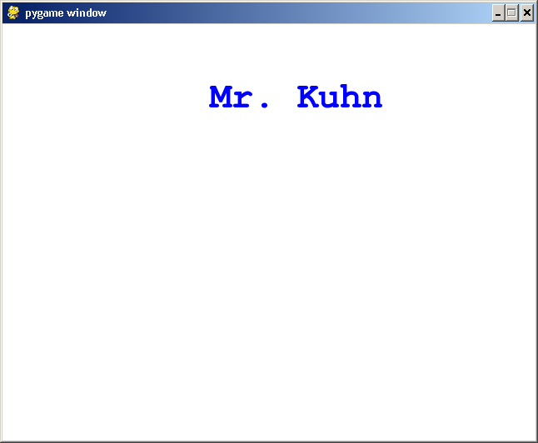
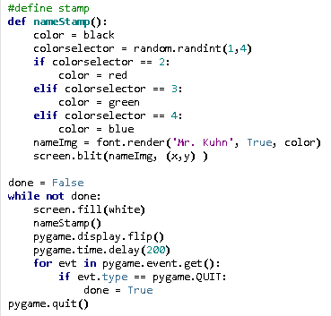
Example 3

Slide 12
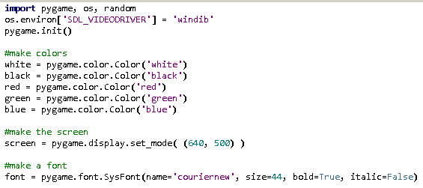
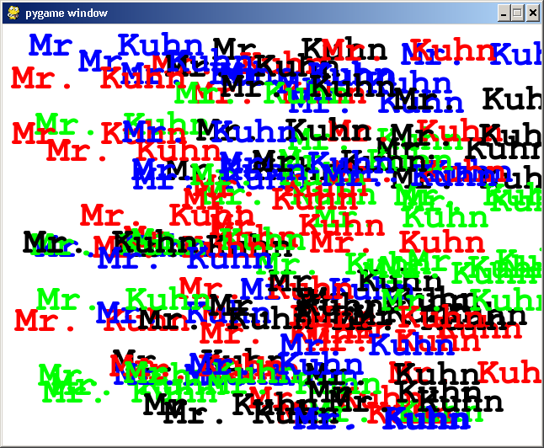
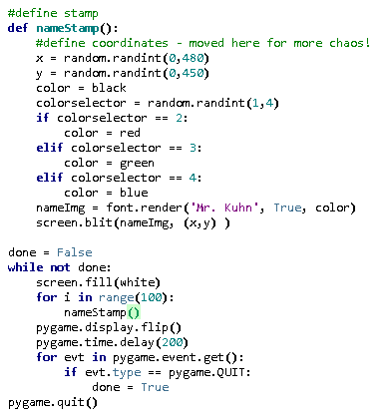
Example 4 – Stamp overload!

